Slide 1
Inventory problems with variable demand or stochastic components

Slide 2
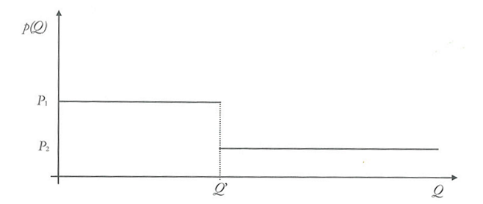
Discounts on supply
Suppose we have the possibility of discounts if you order a certain quantity of goods Q>Q’

Slide 3

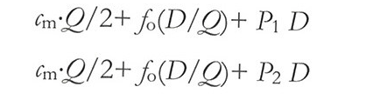
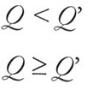
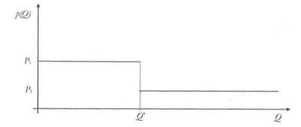
Cost function of the lot with variable costs according to its size

Slide 4
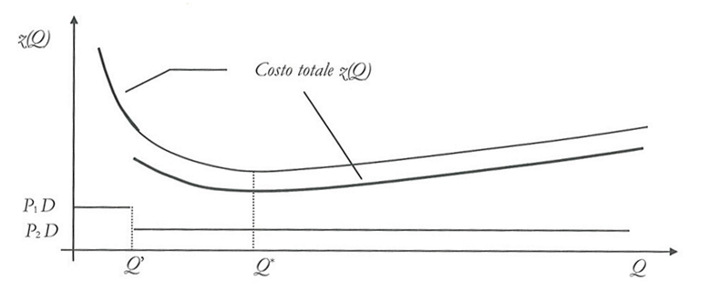
Q’≤Q*
The solution of the economic batch size is Q*

Slide 5
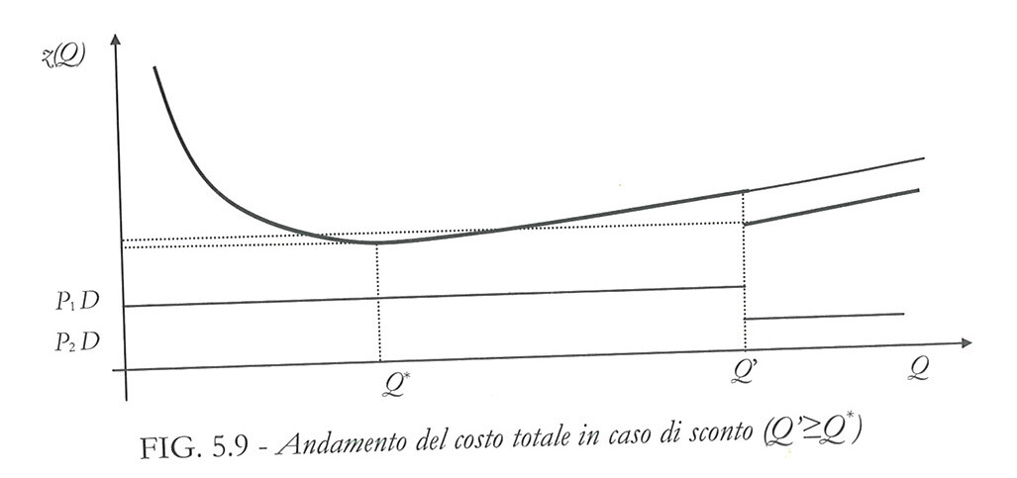
Q’>Q*
Compare z(Q*) with z(Q’)

Slide 6
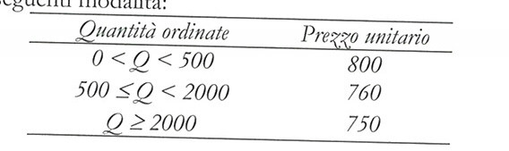
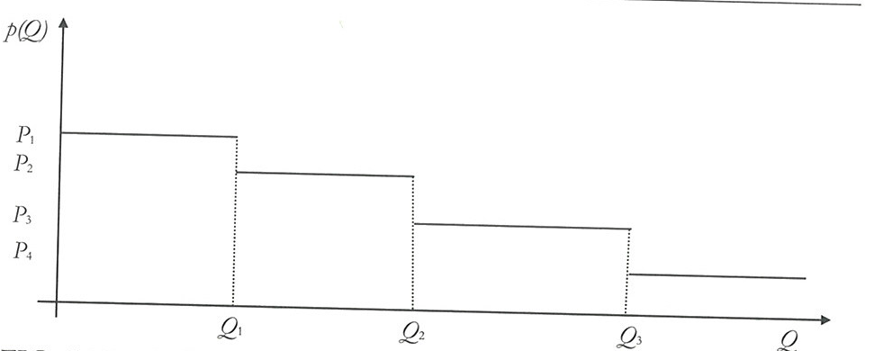
With more discounts

Slide 7
Stochastic continuous models
Suppose demand and / or reorder time non-deterministic => I have to determine all the decision variables simultaneously
reorder point policies that require the reorder of constant quantities each time the stock level reaches the reorder point. The decision variables are the lot size and the reorder point.
periodic reordering policies that provide for the reordering of variable quantities at constant intervals. The decision variables are the supply time and the maximum value of the stock level to be added at each order.

Slide 8
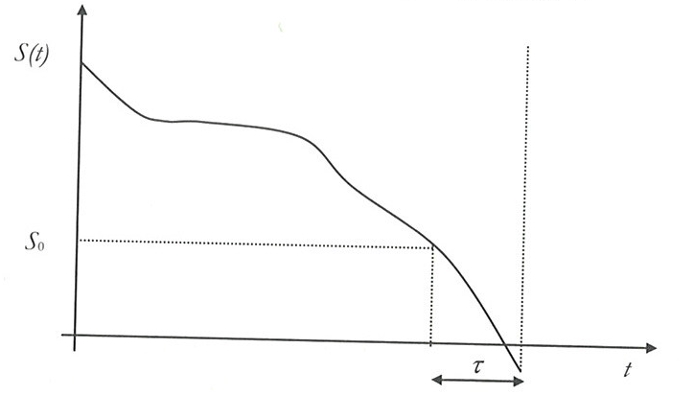

Slide 9
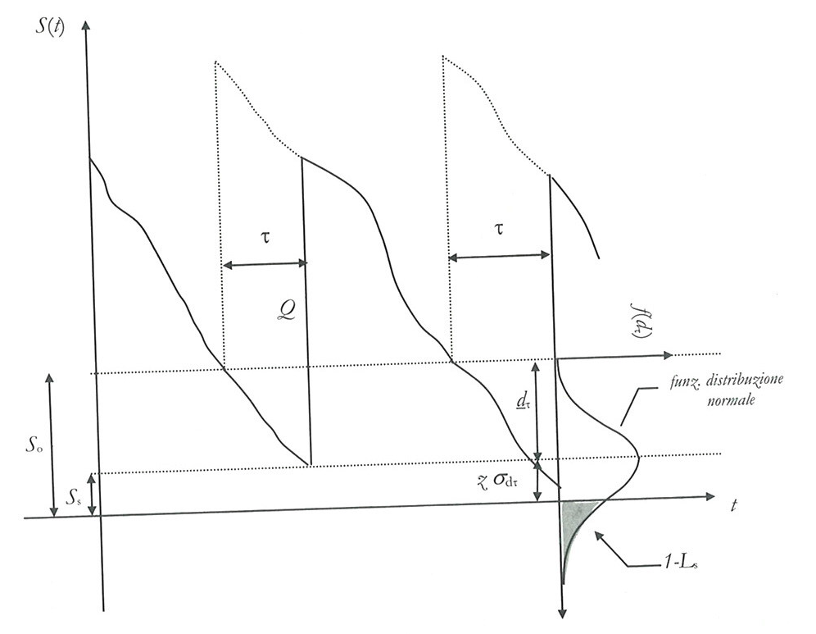

Reorder point policy

Slide 10
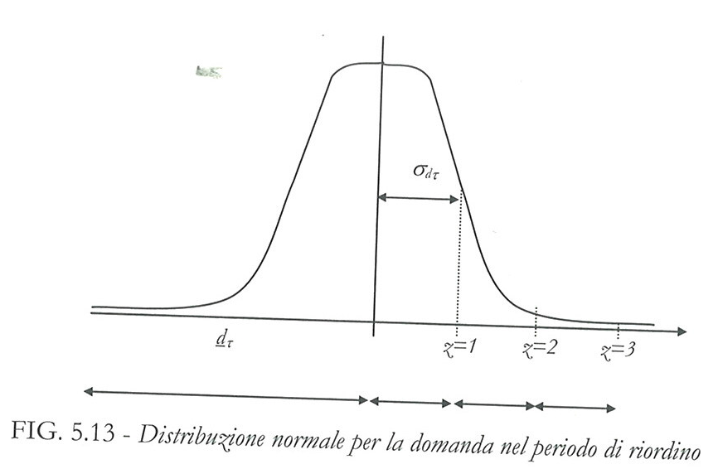

Slide 11
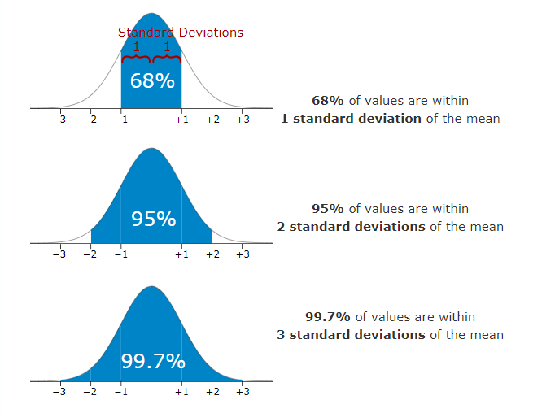


Slide 12
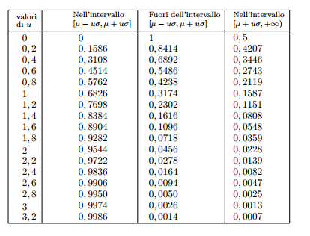

Slide 13
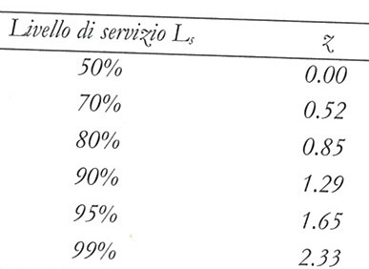

Slide 14
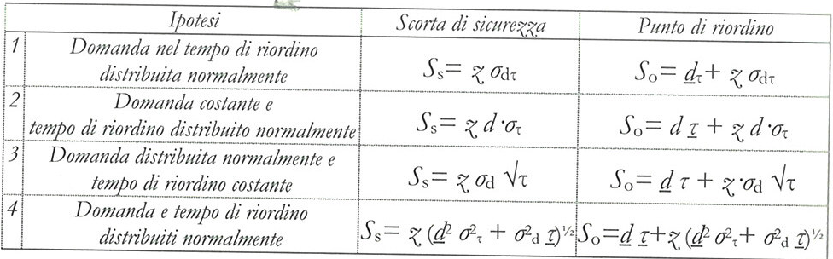
The dimension of the batch can be computed by the economic batch formulation.

Slide 15
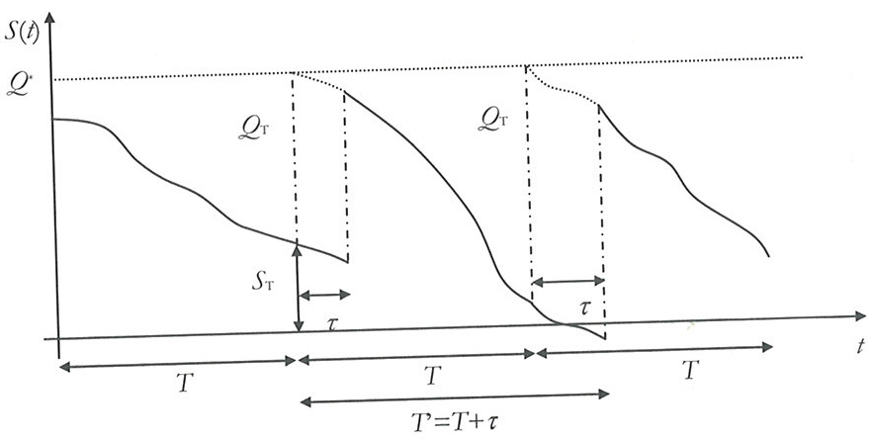
Periodic reorder policy
Given T, we define Q* and the order is Q*-S_{T}

Slide 16




Considering therefore the variable demand according to a normal distribution and constant reorder time, the expression of Q* is equal to
being
average demand in the unit of time (e.g. day or week);
constant reorder time
supply time
multiplication coefficient that varies according to the level of service
standard deviation of the demand
Once computed Q*, if S_{T} is the stock level present in the warehouse when issuing the order, the quantity to be ordered is:
Since the stock level, on average, varies between the S_{s} and Q* levels, the stock average is, with a good approximation, equal to
Determination of the supply time
It can be determined by organizational considerations or assessed through the formula of the economic lot.

Slide 17
Discrete time models
The fundamental model to describe the problem of inventory management of discrete-time stocks is the so-called lot-sizing for a single product.
To illustrate its formulation, the following parameters are introduced:
N number of periods of the programming time horizon;
d_{i} net demand for the period i;
p_{i} purchase or production cost during the period i
c_{i} storage cost per unit of product during the period i
f_{i} ordering or set-up cost relating to period i due to the issue of a new order or the reactivation of production with respect to period i;
s_{i}, product inventory at the end of the period i
and decision variables
- q_{i} quantity to be produced or ordered during the period i
- yi binary variable equal to 1 if at the beginning of the period i an order is issued or production is reactivated with respect to period i-1 (y_{i} = 1 if q_{i-1} = 0 and q_{i}> 0), 0 otherwise.

Slide 18
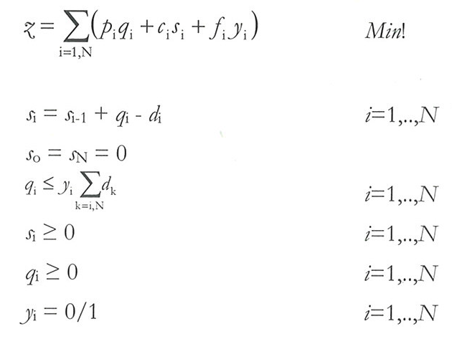
Lot sizing method

Slide 19
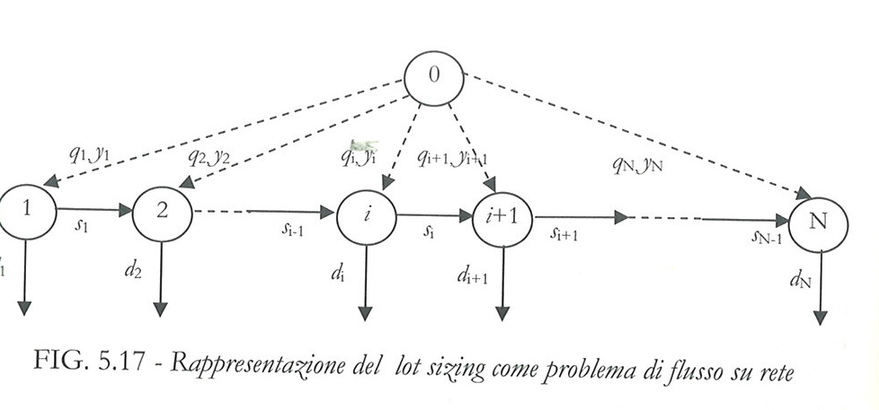
Flow network representation

Slide 20
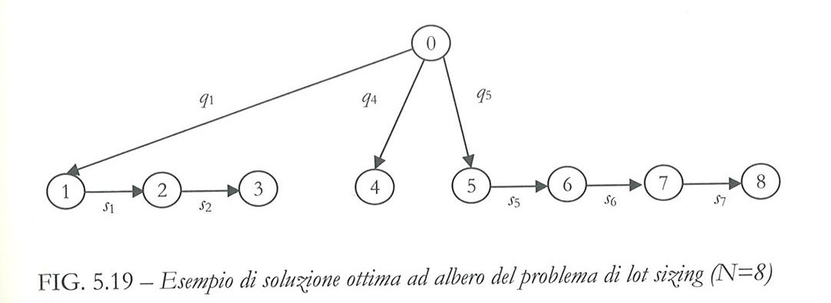
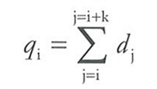

Slide 21
Wagner-Whitin algorithm
The properties described are the basis of the Wagner-Whitin algorithm that allows you to identify the optimal solution of a lot sizing problem in polynomial time. The algorithm dynamically analyzes all possible combinations of orders, identifying the optimal one, solving a problem of minimum path.
In practice, this technique is rarely used for several reasons:
the difficulties of implementing the algorithm,
the need to set a precise time horizon on the basis of which the algorithm determines the optimal solution.
For this reason, several heuristic algorithms have been proposed which constructively determine the policy of managing stocks with reference to a fixed number of periods.

Slide 22
It is an exact method proposing an algorithm to solve the following optimization problem

Slide 23
Wagner-Whitin algorithm definition
T: decision horizon;
q_{t}: batch dimension to be ordered in in terval t, t=1,..,T;
I_{t}: inventory level at the end of interval t, t=1,..,T;
y_{t}: binary variable:
1 if I do an order at instant t
0 otherwise.

Slide 24
Problem properties
1: The optimal solution of the problem satisfies the ZIO property (zero inventory ordering), that is, an order is executed exactly when the inventory level is canceled.
2: The optimal solution of the problem corresponds to the so-called exact requirement policy, that is, each lot has a size equal to the exact sum of an integer number of demand values referred to future intervals.
To determine the optimal dimensions of the lots to be ordered, it is sufficient to determine the moments in which the orders must be issued

Slide 25
3: The problem is equivalent to the problem of determining the minimum path in an acyclic graph with the following characteristics:
T+1 nodes;
Costs related to each link (ti, tj), ti=1,…,T+1, tj=1,…,T+1, are related to the cost (fixed and inventory) of the order satisfying a period from i to (j-1) included.
The determination of the optimal path and therefore of the optimal inventory management policy can be obtained with dynamic programming techniques (e.g. Dijkstra alg.).

Slide 26
An example
We want to solve the problem characterized by the following data:
T = 5 [days];
k = 200 [Euro]; order issue cost
h = 1 [Euro / day unit]; inventory cost per product unit
d = [100, 80, 150, 20, 90]. demand

Slide 27
d=[100, 80, 150, 20, 90]. demand
k=200 [Euro]; order issuing cost

Slide 28
Solution Wagner-Whitin (2):
Optimal path1-3-6, C*= 680 [Euro].
1
2
3
4
5
6
280
400
Optimal solution:
y*=[1, 0, 1, 0, 0]
q*=[180, 0, 260, 0, 0]
I*=[80, 0, 110, 90, 0].

